Slide 1
BodyFat Project
Zhengyong Chen, Xiangsen Dong, Xupeng Tang, Zhaoqing Wu

Slide 2
Overview
Data Cleaning
Model Selection
Trade-off
Final Model

Slide 3
Data Cleaning

Slide 4
Data Cleaning
We converted the unit of Height to cm.
We imputed individual 42's Height due to an unusually low value.
We removed three individuals (IDNO: 39, 41, 216) due to outliers detected across multiple variables using the IQR method.
Individual | Original Value | Imputed Value | Imputation Method
42 | 74.93 cm | 181.47 cm | Used ADIPOSITY
Individual | Outlier_Variables
39 | WEIGHT, ADIPOSITY, NECK, CHEST, ABDOMEN, HIP, THIGH, KNEE, ANKLE, BICEPS, WRIST
41 | WEIGHT, ADIPOSITY, CHEST, ABDOMEN, HIP, THIGH, WRIST
216 | BODYFAT, DENSITY, ADIPOSITY, ABDOMEN

Slide 5
Data Cleaning
We deleted column DENSITY and IDNO.
We scaled the data before modeling.
Final Data: 249 rows with 14 predictors
Predictors: AGE, WEIGHT, HEIGHT, ADIPOSITY, NECK, CHEST, ABDOMEN, HIP, THIGH, KNEE, ANKLE, BICEPS, FOREARM, WRIST

Slide 6
Model Selection

Slide 8

Model Construction Principles
Select variables:
Stepwise regression
Reason:
Stepwise regression iteratively adds or removes predictors, effectively identifying the most valuable variables for predicting body fat and excluding those with lesser contributions.
Initial Comprehensive Model:
Starting with a broad model that includes:
BODYFAT ~ AGE + WEIGHT + NECK + ABDOMEN + THIGH + FOREARM + WRIST
Through stepwise regression, we filter out the most crucial variables for predicting body fat percentage.

Slide 9
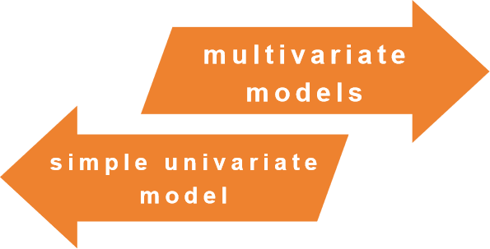

Consideration of Candidate Models
Subsequently, added more variables to build multivariate models:
BODYFAT ~AGE+WEIGHT+ ABDOMEN+NECK+THIGH
Considering the effects of age, weight, and abdominal circumference among others.
Firstly tested a simple univariate model:
BODYFAT~ABDOMEN
Abdomen is an important indicator due to its high correlation with body fat content.
Reasons: Based on literature review and initial data analysis.
Example: Multiple studies have demonstrated a strong correlation between abdominal circumference and body fat;
Age and weight are also important factors affecting body fat distribution.

Slide 10
Trade-off

Slide 11
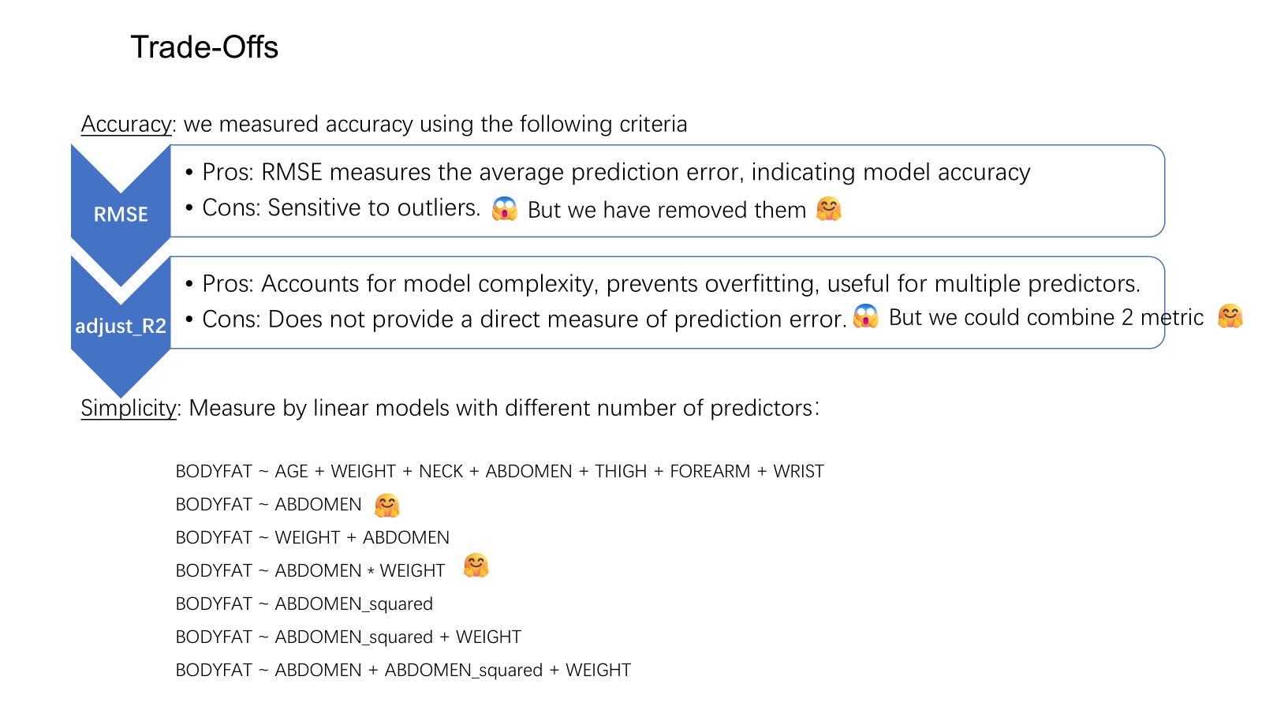

Slide 12
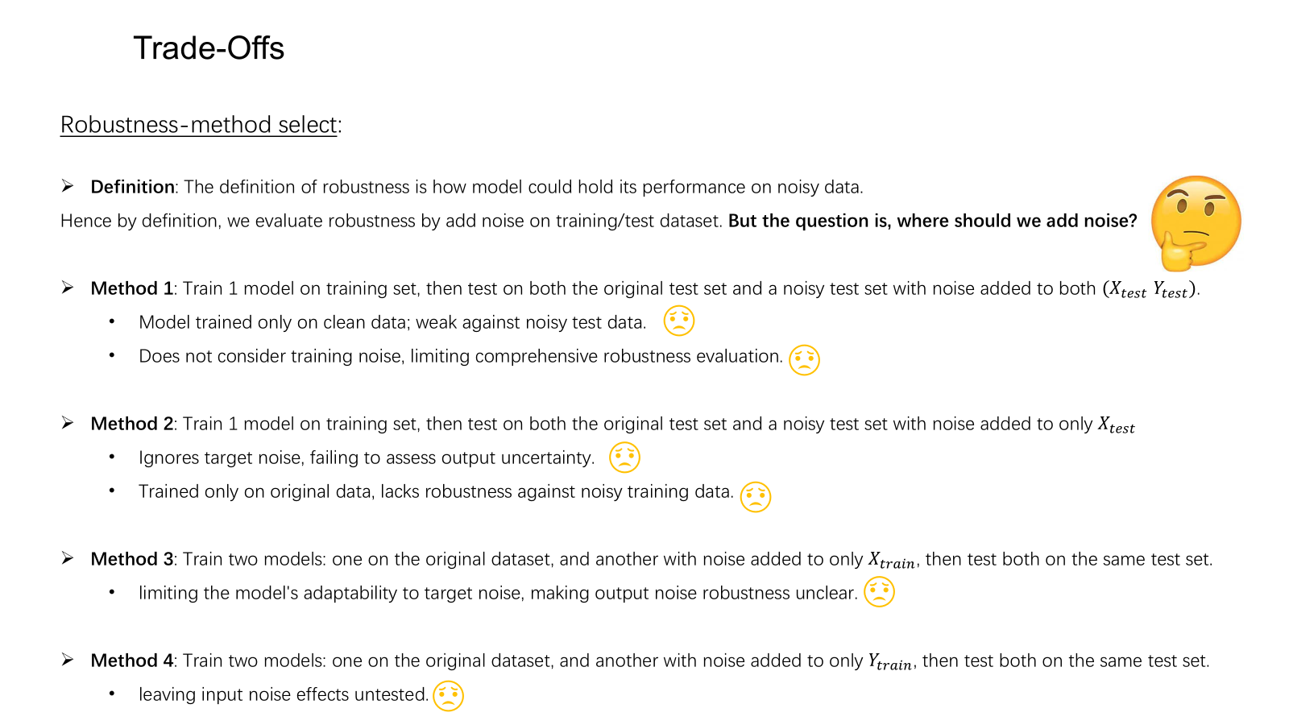

Slide 13
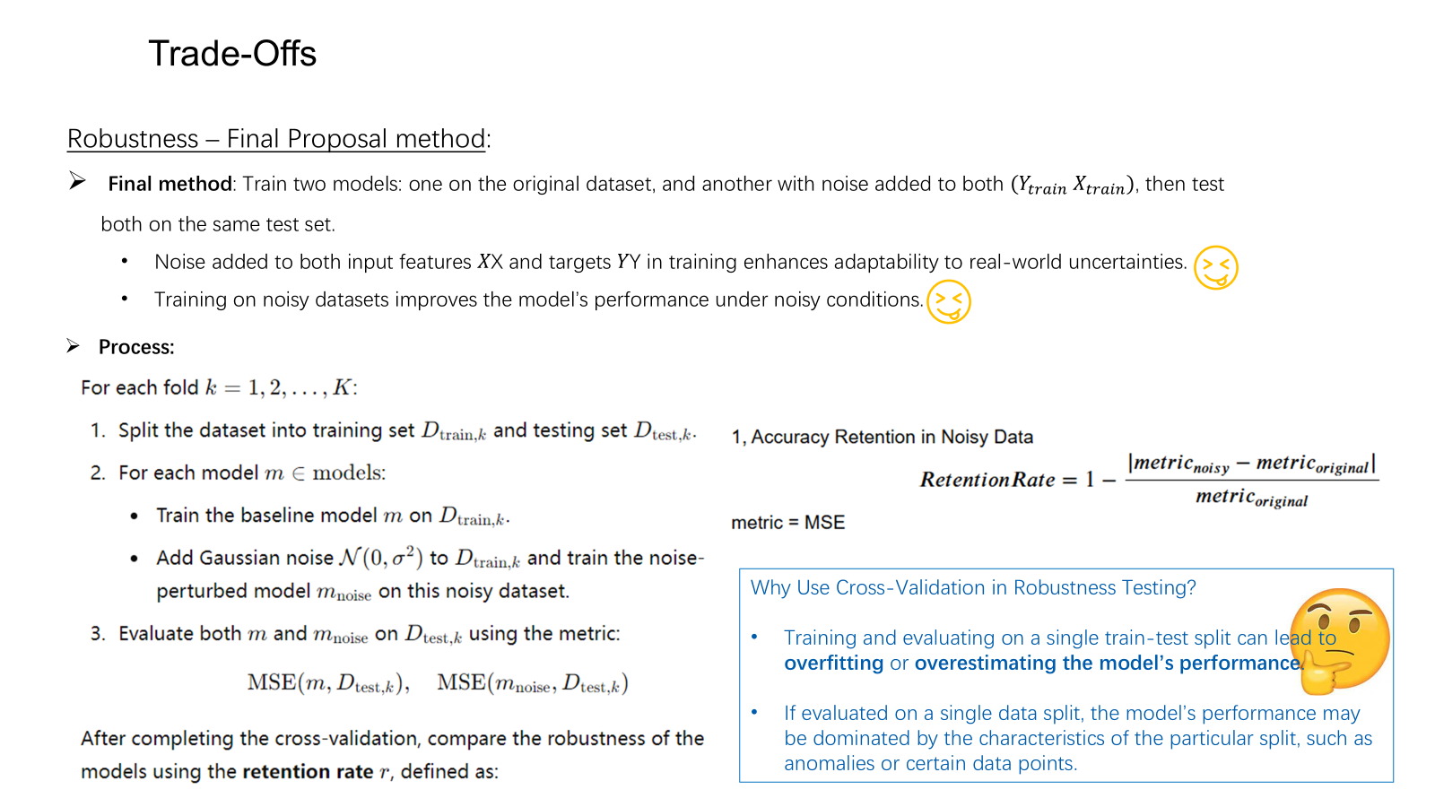

Slide 14
Results
model | adjusted_R | MSE | retention_MSE_rate | num_predictors
BODYFAT ~ AGE + WEIGHT + NECK + ABDOMEN + THIGH + FOREARM + WRIST | 0.727 | 0.272 | 0.978 | 7
BODYFAT ~ ABDOMEN | 0.666 | 0.33 | 0.993 | 1
BODYFAT ~ WEIGHT + ABDOMEN | 0.708 | 0.292 | 0.987 | 2
BODYFAT ~ ABDOMEN * WEIGHT | 0.023 | 0.978 | 0.982 | 1
BODYFAT ~ ABDOMEN_squared | 0.013 | 0.985 | 0.999 | 1
BODYFAT ~ ABDOMEN_squared + WEIGHT | 0.539 | 0.461 | 0.997 | 2
BODYFAT ~ ABDOMEN + ABDOMEN_squared + WEIGHT | 0.709 | 0.286 | 0.981 | 3

Slide 15
Final Model

Slide 16
Bodyfat = 1.18*Abdomen - 0.42Weight.
sample mean of Bodyfat = 18.94%, sample sd of Bodyfat = 7.75%,
sample mean of Abdomen = 92.08 cm, sample sd of Abdomen = 9.85 cm,
sample mean of Weight = 177.69 lbs, sample sd of weight = 26.48 lbs.

Slide 17
P-value of predictors is greatly less than 0.01, which indicates statistical significance.

Slide 18
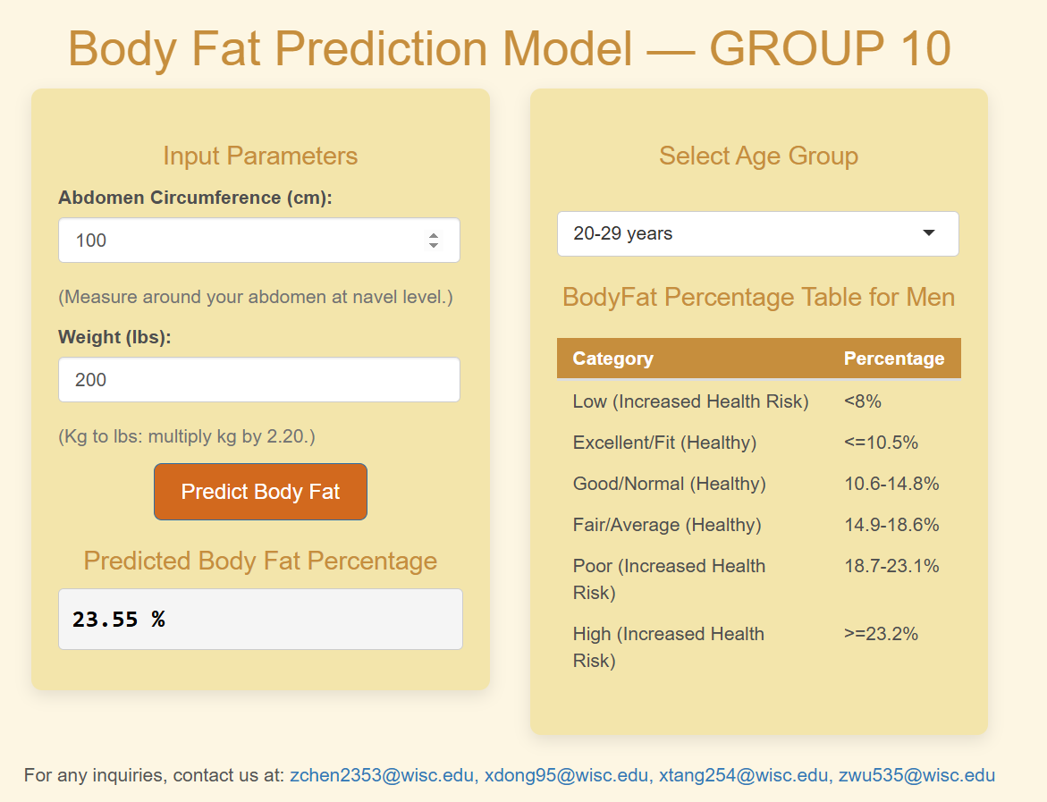
Example
We have developed this model into a Shiny app: https://andrewchanshiny.shinyapps.io/Bodyfat-Group10-P2-628/

Slide 19

Example
A man of 200 lbs weight and 100 cm abdomen circumference, his body fat is predicted to be:

Slide 20
Strength:
Easy to use.
A certain level of accuracy.

Slide 21
Weakness
Contradicts with common sense.
(cov(bodyfat,weight) < 0)

